Slide 1
Valuing Healthcare: Measuring What Matters
Professor Deborah Schofield
Chair of Health Economics
Dr Michelle Cunich, Ms Sarah West, Dr Rupendra Shrestha
Faculty of Pharmacy
The University of Sydney
#PharmAus2017

Slide 2
Population Change
In 2002: > five people of working age to support every person aged over 65.
By 2042, only 2.5 people of working age supporting each person aged over 65.
#PharmAus2017

Slide 3
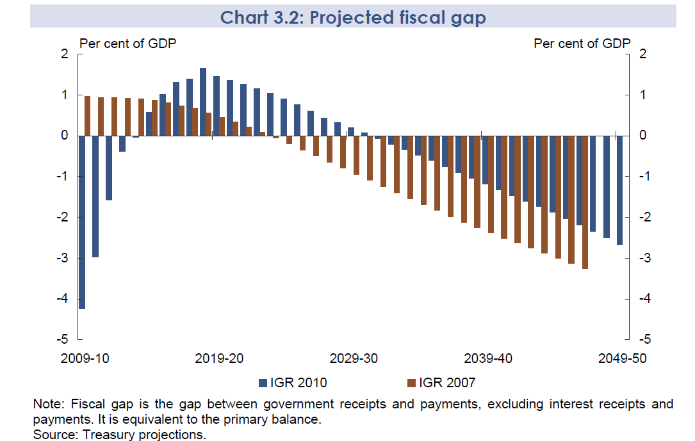
The Intergenerational Report
#PharmAus2017
The Treasury Intergenerational report 2010. Canberra: Commonwealth of Australia, 2010

Slide 4
Projections of Australian Government
Spending by Category
#PharmAus2017
Source: Intergenerational Report 2015

Slide 5

So What Should We Measure?
#PharmAus2017

Slide 6
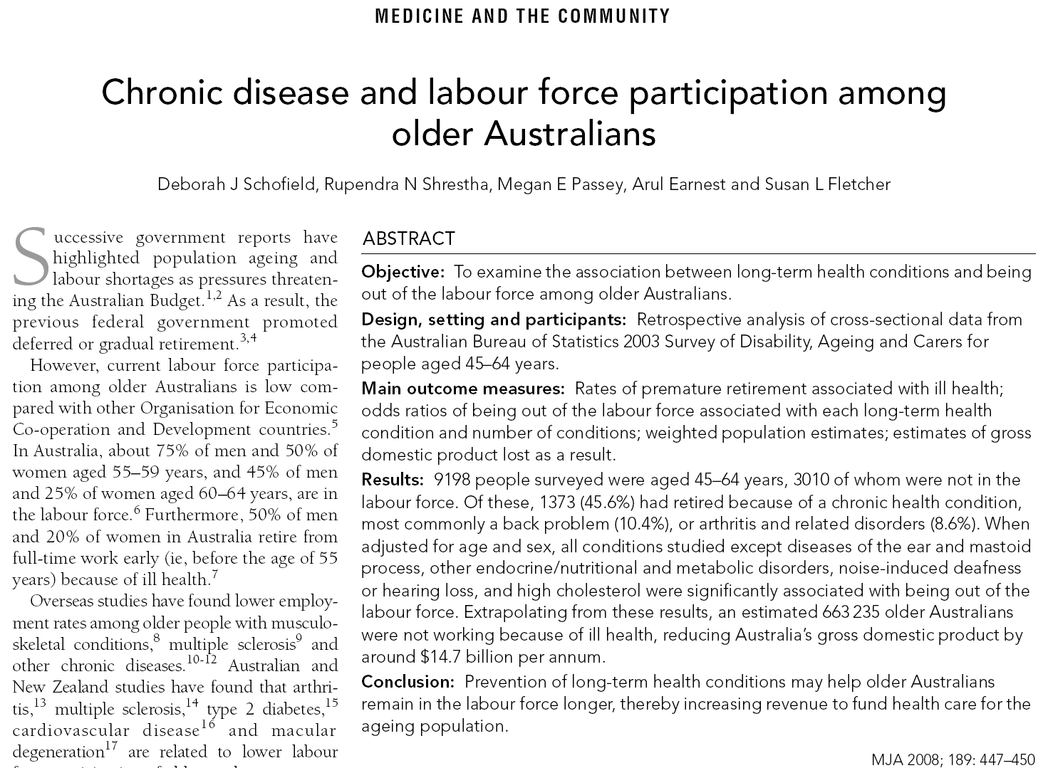
Impact of Chronic Disease on
Labour Force Participation
#PharmAus2017

Slide 7
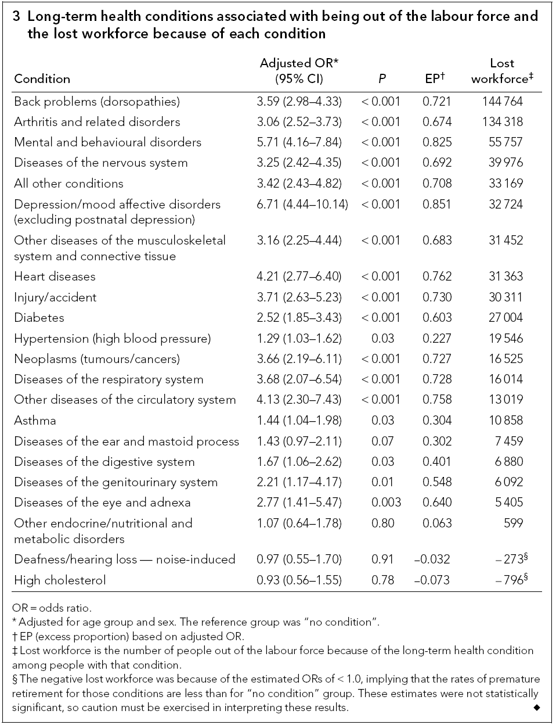
Impact of Chronic Diseases on Labour Force Participation MJA 2008 189:447-450
#PharmAus2017

Slide 8
Flow Chart for Selection of Productivity Measures Used in OA Analyses
#PharmAus2017

Slide 9
Measures of Productivity
Commonly Used Instruments
Work Productivity and Activity Impairment Questionnaire (WPAI)
  - WPAI-SHP_English_US_V2.doc
Work Activity Limitations Survey (WALS)
  - WALS questionnaire.pdf
The Work Limitations Questionnaire (WLQ)
PRoductivity and DISease Questionnaire (PRODISQ)
#PharmAus2017

Slide 10
Work Productivity and Activity Impairment Questionnaire: Specific Health Problem V2.0 (WPAI:SHP)
The following questions ask about the effect of your PROBLEM on your ability to work and
perform regular activities. Please fill in the blanks or circle a number, as indicated.
Are you currently employed (working for pay)? _____NO ___ YES
If NO, check “NO” and skip to question 6.
The next questions are about the past seven days, not including today.
During the past seven days, how many hours did you miss from work because of problems
associated with your PROBLEM? Include hours you missed on sick days, times you went in
late, left early, etc., because of your PROBLEM. Do not include time you missed to participate
in this study.
_____ HOURS
#PharmAus2017
Notes:
Q for speaker – are these handouts?

Slide 11
Work Productivity and Activity Impairment Questionnaire: Specific Health Problem V2.0 (WPAI:SHP)
During the past seven days, how many hours did you miss from work because of any other
reason, such as vacation, holidays, time off to participate in this study?
_____HOURS
During the past seven days, how many hours did you actually work?
_____HOURS (If “0”, skip to question 6.)
#PharmAus2017
Notes:
Q for speaker – are these handouts?

Slide 12
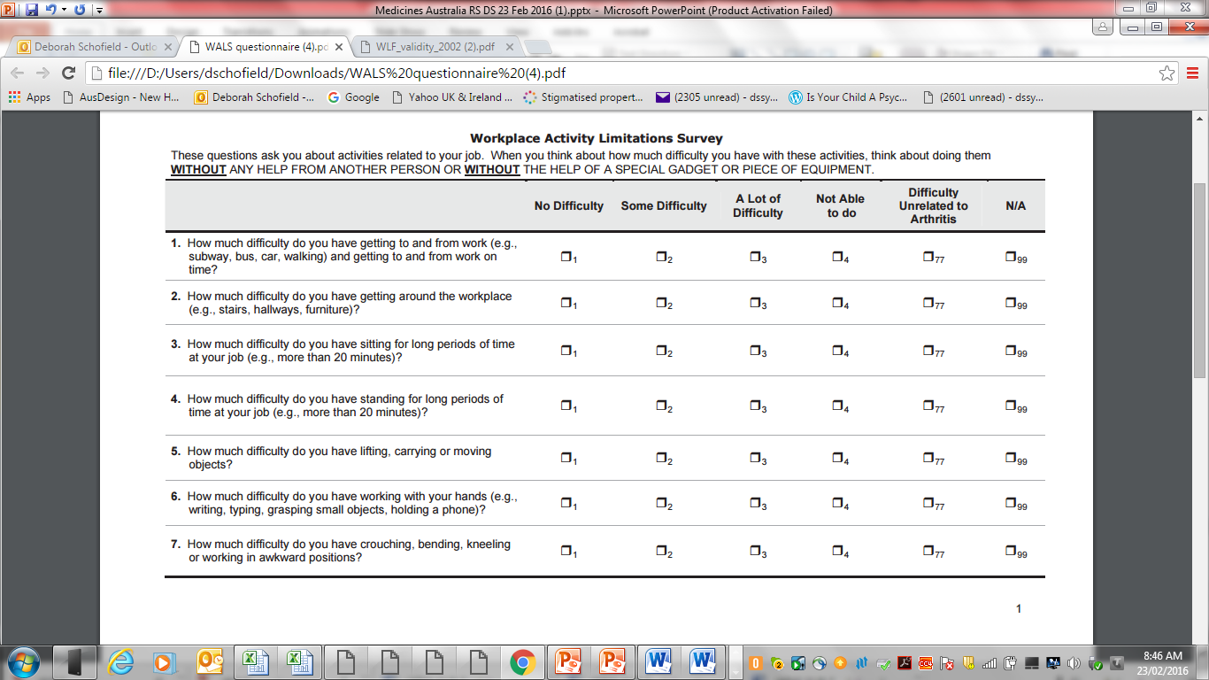
Work Activity Limitations Survey (WALS)
#PharmAus2017

Slide 13
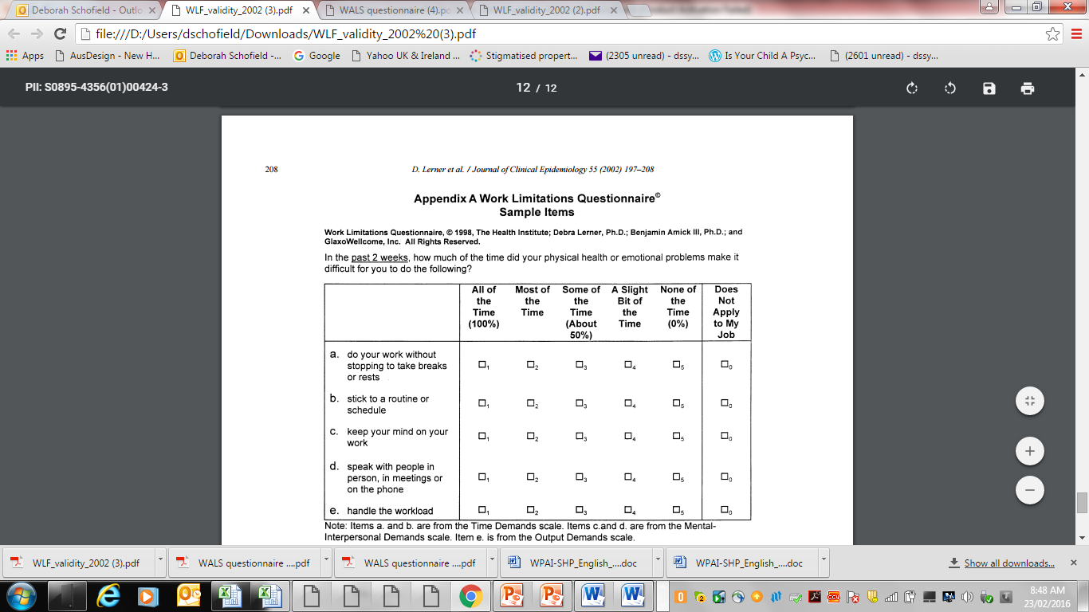
Work Limitations Questionnaire (WLQ)
#PharmAus2017

Slide 14
Framework for Productivity Measure
Are you in paid employment ?
Yes
No
What are your ususal hours of weekly work?
What is your main reason for this?
eg. ill health
If part
time
What is
your current annual salary?
Have you taken
a lower paid job due to your [osteoarthritis]?
What was the size of your pay cut?
If yes
Have you taken any time off due to your [osteoarthritis] in the last [four] weeks?
How many hours did you take off in total?
How was the cost of these hours covered? eg. paid sick leave, unpaid leave, workers comp, other
#PharmAus2017

Slide 15
Framework for Productivity Measure
Yes
Are you in paid employment ?
No
What is your main reason for this? eg. ill health
If no
Are you seeking employment?
How long has it been since you last worked?
What was your previously weekly income in your last paid job?
What was your previously weekly income before you developed [osteoarthritis]
What type of payments do you receive?
Do you receive any social security payments?
#PharmAus2017
How much are your total social security payments per fortnight?

Slide 16
Framework for Productivity
Recommend use of other existing instruments (eg. WPAI) if presenteeism to be mentioned
Lifetime economic impacts to be modelled
Lost income tax revenues to be imputed through data linkage/microsimulation
Lost GDP to modelled
#PharmAus2017

Slide 17

A Vision of the Future:
Value Measured in the Frontiers of Medicine
#PharmAus2017

Slide 18
Cost-effectiveness of Singleton Whole Exome Sequencing Compared with Standard Diagnostic Care
Under review Zornitza Stark, Deborah Schofield, Khurshid Alam, Bill Wilson, Nessie Mupfeki, Ivan Macciocca, Rupendra Shresthra, Susan M White⁶, Clara Gaff
Tests and assessments | Standard diagnostic care (AU$) |  | WES as a last resort | WES replacing some investigations (AU$) | WES replacing most investigations (AU$)
Average cost per patient (95%CI) | 4733.81 (3693.33, 5894.96) |  | 8384.13 (7078.51, 9619.00) | 5913.79 (5242.69, 6640.83) | 3751.79 (3751.79, 3751.79)
Number of diagnoses made | 7 |  | 25 | 25 | 25
Cost per diagnosis (95%CI) | 27050.36 (15365.51, 68529.77) |  | 13414.61 (10164.61, 18351.32) | 9462.06 (7497.48, 12618.76) | 6002.86 (4841.02, 7898.51)
Incremental cost per additional diagnosis (Base: Standard diagnostic care) | - |  | 8111.82 (5850.95, 11966.87) | 2622.16 (847.09, 4459.16) | -2182.27 (-5855.02, 129.92)
> 4 X
#PharmAus2017

Slide 19






Why Do We Need Cost Effectiveness
Revenue neutral/offset
#PharmAus2017

Slide 20
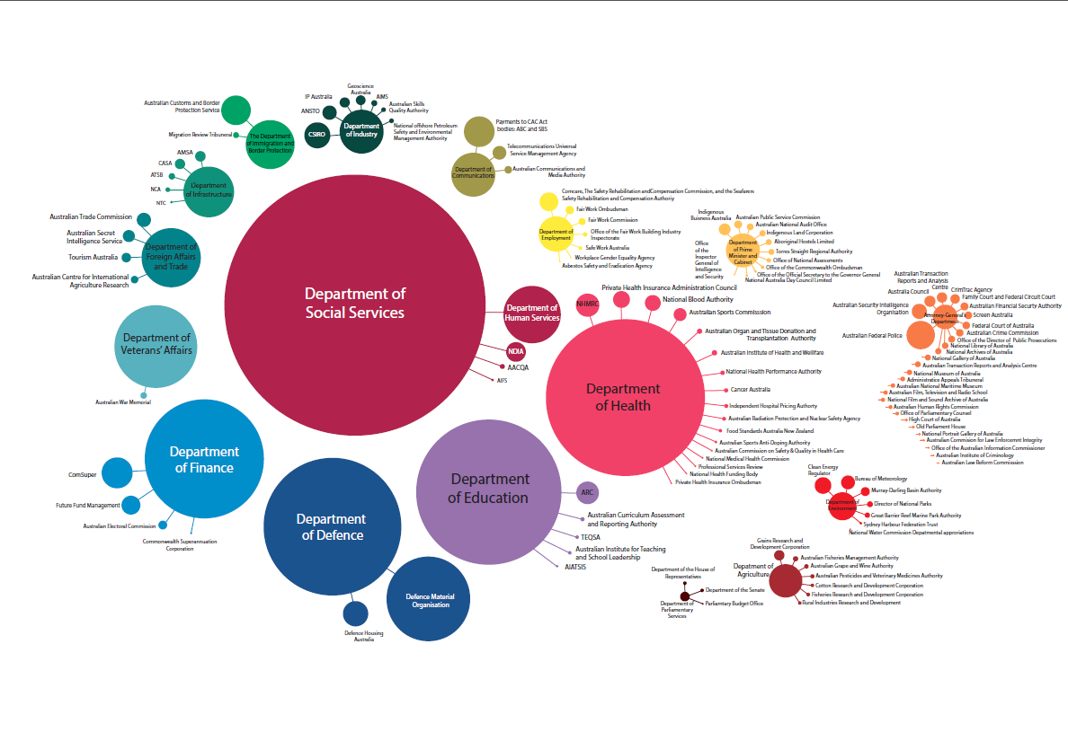
2014-15 Federal Budget
With thanks to Professor Aiden Byrne, CEO Australian Research Council

Slide 21
2014-15 Federal Budget
(Treasury omitted)
With thanks to Professor Aiden Byrne, CEO Australian Research Council

Slide 22
Ripple Effects
Maternal labour force participation
A German study of families whose babies were born with a cognitive or physical disability found that two
years after birth there was a significant negative effect on mother’s labour force participation .
Amongst US welfare recipients who had a job, those who had a child with a mobility or cognitive disability
were 33% more likely to experience a job loss.
Parental income and poverty
US families with a disabled child were found to be significantly more likely to be welfare dependent
Parental health
Significantly higher levels of depression have been reported amongst mothers of autistic children or
children with behavioural disorders compared to those of children with normal development.
Poor maternal health was a further barrier to mothers of disabled children returning to the paid labour force.
#PharmAus2017

Slide 23
Review of Costs of Intellectual Disability
Brett Doble, Deborah Schofield, John Mattick,
Tony Roscioli
Cost of severe to profound intellectual disability – but data is limited, and based on
small samples with no identified cause of ID
Costs of severe to profound disability
Health costs pa | $1,500-$30,000
Accomodation costs | $3,000 - $375,000
Education | $0 - $75,000
Day activities | $0 – 12,000
Welfare costs | Approx. $8,000
Carer | $60,000-$135,000
#PharmAus2017

Slide 24
Measurement in EPIC-ID
Cost of testing and treatment costs
Aids and appliances
Home modifications
Effect of treatment – child health/disability
Parent health
QoL/Utility
Education costs
Accommodation costs, respite care,
day care
Transport subsidies
Family relationship status
Labour force participation (affected person and carer), income
Welfare payments
Public housing
Family planning – extended family
#PharmAus2017

Slide 25
Thank You
Some of this research was funded by Medicines Australia
#PharmAus2017

