Slide 1
The Challenges of Unlocking Health Data
Ms Kylie Sproston Chief Executive Officer Bellberry
#PharmAus2017
@smiliekylie

Slide 2
“Some day, on the corporate balance sheet, there will be an entry which reads, "Information"; for in most cases, the information is more valuable than the hardware which processes it”
Rear Admiral Grace Hopper
#PharmAus2017

Slide 3
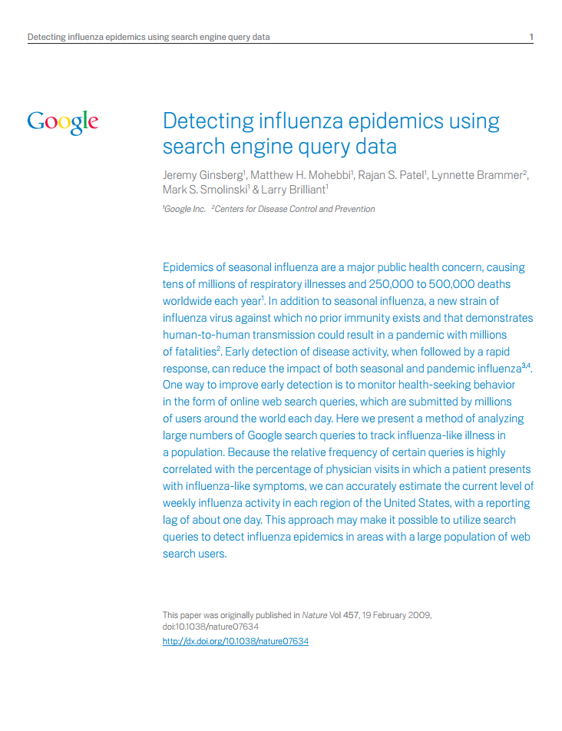
#PharmAus2017

Slide 4
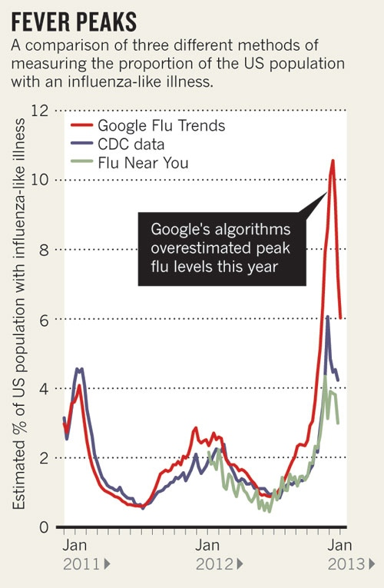
#PharmAus2017

Slide 5
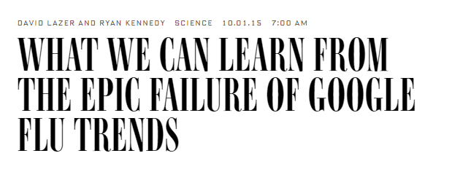
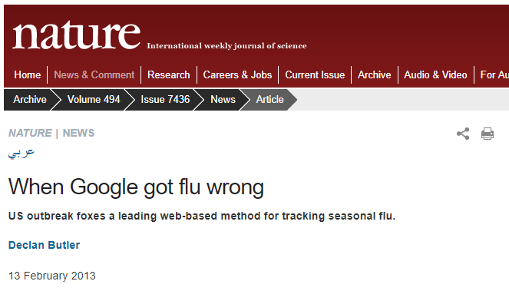
#PharmAus2017

Slide 6
Algorithm & prediction
Fixed vs Learning
#PharmAus2017

Slide 7
#PharmAus2017

Slide 8
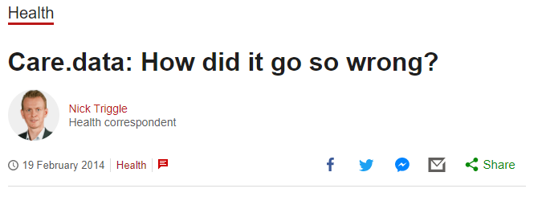
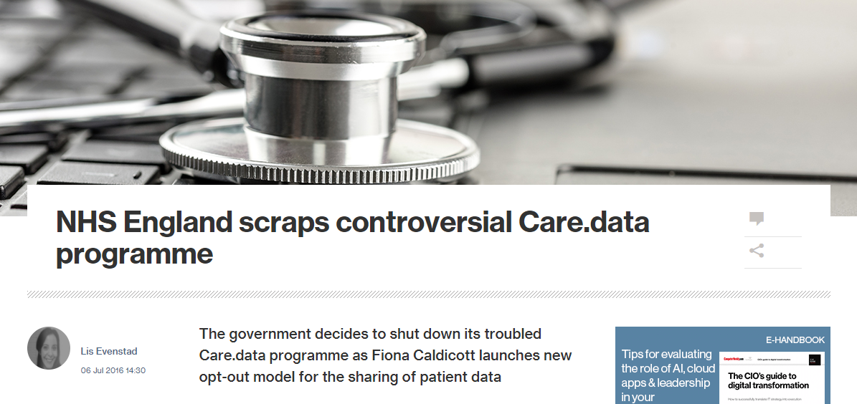
No Independent Oversight
Fully Informed?
Commercial Sale of Data
#PharmAus2017

Slide 9
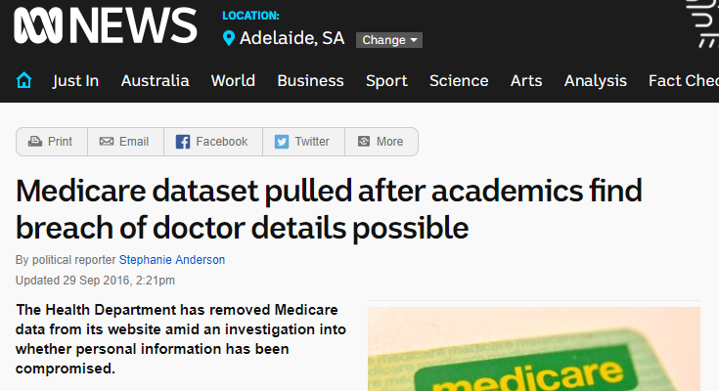
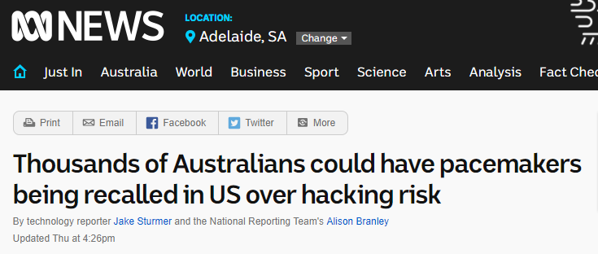
#PharmAus2017

Slide 10
Reidentification
Clinical vs Commercial?
Data Security and Cyber Risk
#PharmAus2017

Slide 11
The Origins of Personal Data and It’s Implications for Governance
Provided | Observed | Derived | Inferred
SELF-INITIATED Online purchase | USER ENGAGED Cookies Location-enabled device | COMPUTATIONAL Credit ratios Average purchase per visit | STATISTICAL Credit score Life Expectancy Crime hotspots Traffic Patterns
COMPELLED Applications | NOT ANTICIPATED Sensors in cars | NOTATIONAL Classification of buyer attributes. Medical condition based on diagnostic tests | ADVANCED ANALYTICAL Risk of developing disease based on multi-factor analysis. College success prediction based on big data analysis at age 9.
TRANSACTIONAL Eg Bills Paid | PASSIVE Facial images from CCTV WiFi data Call logs
POSTED Instagram Twitter
#PharmAus2017
Abrams, Martin, The Origins of Personal Data and its Implications for Governance (March 21, 2014). Available at SSRN: https://ssrn.com/abstract=2510927 or http://dx.doi.org/10.2139/ssrn.2510927

Slide 12
High Level of Personal Awareness Low
Provided | Observed | Derived | Inferred
SELF-INITIATED Online purchase | USER ENGAGED Cookies Location-enabled device | COMPUTATIONAL Credit ratios Average purchase per visit | STATISTICAL Credit score Life Expectancy Crime hotspots Traffic Patterns
COMPELLED Applications | NOT ANTICIPATED Sensors in cars | NOTATIONAL Classification of buyer attributes. Medical condition based on diagnostic tests | ADVANCED ANALYTICAL Risk of developing disease based on multi-factor analysis. College success prediction based on big data analysis at age 9.
TRANSACTIONAL Eg Bills Paid | PASSIVE Facial images from CCTV WiFi data Call logs
POSTED Instagram Twitter
#PharmAus2017
Abrams, Martin, The Origins of Personal Data and its Implications for Governance (March 21, 2014). Available at SSRN: https://ssrn.com/abstract=2510927 or http://dx.doi.org/10.2139/ssrn.2510927

Slide 13
High Level of Personal Awareness Low
Provided | Observed | Derived | Inferred
SELF-INITIATED Online purchase | USER ENGAGED Cookies Location-enabled device | COMPUTATIONAL Credit ratios Average purchase per visit | STATISTICAL Credit score Life Expectancy Crime hotspots Traffic Patterns
COMPELLED Applications | NOT ANTICIPATED Sensors in cars | NOTATIONAL Classification of buyer attributes. Medical condition based on diagnostic tests | ADVANCED ANALYTICAL Risk of developing disease based on multi-factor analysis. College success prediction based on big data analysis at age 9.
TRANSACTIONAL Eg Bills Paid | PASSIVE Facial images from CCTV WiFi data Call logs
POSTED Instagram Twitter
Low Need for Independent Oversight High
#PharmAus2017
Abrams, Martin, The Origins of Personal Data and its Implications for Governance (March 21, 2014). Available at SSRN: https://ssrn.com/abstract=2510927 or http://dx.doi.org/10.2139/ssrn.2510927

Slide 14
Public Views? (Aus 2006, n=700)
#PharmAus2017

Slide 15
National Statement Considerations for Research Ethics
Research Merit & Integrity
Justice
Beneficence
Respect
#PharmAus2017

Slide 16
“If (we) are too cautious, (we) risk suppressing valuable… research. If we are not cautious enough, (we) risk harming individuals”
National Research Council (2014)
Proposed revisions to the Common Rule for the Protection of Human Subjects in the Behavioural and Social Sciences
Washington, DC.
#PharmAus2017

Slide 17
Thank You
#PharmAus2017

